Slide 1


Angular basics
Jordi Serra Gonzalez
http://www.linkedin.com/in/jordi-serra-gonzalez/

Slide 2
Introduction
Introduction
Angular
TypeScript
FrontEnd Architecture
Notes:
In this course we’ll learn the Angular basics but we’ll also learn main TypeScript concepts as well as some important principles of FrontEnd architectures with Angular

Slide 3
JavaScript Timeline
Introduction
New syntax
June 1997
ECMAScript 1
June 1998
ECMAScript 2
December 1999
ECMAScript 3
December 2009
ECMAScript 5
ES5
June 2015
ECMAScript 6
ES6/ES2015
June 2016
ECMAScript 7
ES7/ES2016
June 2017
ECMAScript 8

Slide 4
JS Frameworks Timeline
Introduction
October 2012
TypeScript
March2005
Dojo
August 2006
jQuery
March 2007
Mootools
October 2010
BackboneJS
October 2010
AngularJS
March 2013
ReactJS
September 2016
Angular

Slide 5
Architecture Overview

Slide 6
Architecture Overview
Architecture & Setup
Modules
Components
Directives
Routing
Services
Pipes
Notes:
The typical architecture of an angular application is made up of these five building blocks

Slide 7
Architecture Overview
Architecture & Setup
Modules
<>
Building blocks that contain routes, components, services and more.
Notes:
A module is a main building block of an angular application so we can have multiple modules, we can have a single module, we can have modules that deepens on other modules. Therefore, a module is a building block that can contain specific components like featured components, a service to call a backend or a route to know where to navigate on a specific path.

Slide 8
Architecture Overview
Architecture & Setup
Email client example
Search
Chat
Inbox
Notes:
Each of these can be a module that contain specific components and services for a purpose.

Slide 9
Architecture Overview
Architecture & Setup
Components
<>
Contains a template, data and logic, forming part of a DOM tree.

Slide 10
Architecture Overview
Components Architecture
Architecture & Setup
<>
<>
<>
<>
<>
<>
<>
Notes:
A component is a high level DOM tree node which will then create subtree nodes. These is an example of how our node tree would look like. Each component then can run html code inside and the logic to manage data bindings on it. This is what we know as “Component Architecture”

Slide 11
Architecture Overview
Architecture & Setup
Directive
<>
Attach behaviour, extend or transform a particular element and its children.
Notes:
A directive is something we can bind to an existing DOM element or just use it in a template on its own, which will extend or transform a particular element on its children.

Slide 12
Architecture Overview
Components Architecture
Architecture & Setup
<>
<>
<>
<>
<>
<>
<>
<>
Notes:
Now on the tree we can see a directive bound to a component. For example, this could be a search component and we could want to attach a directive to listen some particular event in order to perform an action over the element. Angular also provides several built-in directives that we will ease the development of applications.

Slide 13
Architecture Overview
Architecture & Setup
Services
<>
Data layer, logic that is not component related, such as API requests.
Notes:
A service is basically our data layer. How do we get data into a component? A service will be the way to get and format the data in order to pass it in to a component. We can also use them to perform some particular logic non-component related or even listening internal events on the app, so we can then catch the message, format it and send it to the component.

Slide 14
Architecture Overview
Components Architecture
Architecture & Setup
<>
<>
<>
<>
<>
<>
<>
<>
<>
Notes:
Now on the tree we can see a service that it’s bound to a component.

Slide 15
Architecture Overview
Architecture & Setup
Routing
<>
Renders a component based on the URL state, drives navigation.
Notes:
Routing drives the navigation for our application.

Slide 16
Architecture Overview
Components Architecture
Architecture & Setup
<>
<>
<>
<>
<>
<>
<>
<>
<>
Notes:
Now on the tree we can see a pink component, this is just a normal component but we might want to change the child component based on the URL. For example, for the URL /inbox we might want to render the left component and for /service the right component, this routing component will decide which children needs to be call and in this way, we are able to render dynamic components.

Slide 17
Architecture Overview
Architecture & Setup
Pipes
<>
A pipe takes in data as input and transforms it to a desired output.
Notes:
Routing drives the navigation for our application.

Slide 18
Architecture Overview
Components Architecture
Architecture & Setup
<>
<>
<>
<>
<>
<>
<>
<>
<>
<>

Slide 19
Set up instructions
Notes:
In this course we’ll learn the Angular basics but we’ll also learn main TypeScript concepts as well as some important principles of FrontEnd architectures with Angular

Slide 20
Setup instructions
Architecture & Setup
This course has been developed with the following tools which we recommend to use in order to follow up with the explanations although they are not mandatory
Tools
Text editor: Visual Studio Code, you can download it here for both Mac, Windows and Linux.
(VSCode Plugin) Angular Language features: Link here
(VSCode Plugin) VSCode Icons: Link here
Browser: Google Chrome, you can download it here.
Prerequisites
Please make sure that you have the following installed:
Install the latest version of Node.js (Mac or Windows)
Typescript if you haven’t already got it installed: npm install –g typescript
Node Sass, you may need it if you haven't already got it installed: npm install -g node-sass
Angular CLI: npm install –g @angular/cli

Slide 21
Setup instructions
Architecture & Setup
We will use the angular CLI tool to start a new project so lets create one:
We can find all information about angular CLI here.
$ ng new angular-basics-app
$ cd angular-basics-app
$ ng serve

Slide 22
TypeScript & ES6

Slide 23
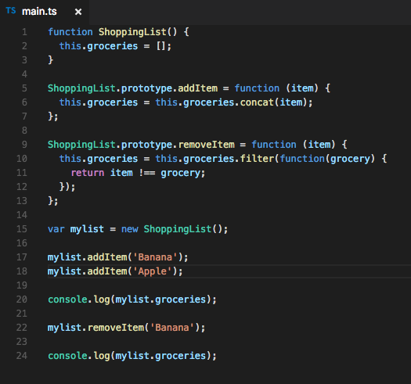
Classes, Spread operator, Arrow function, Immutability
ES5 to ES6 and TypeScript
Notes:
This is a normal JavaScript ES5 syntax code where we will created a ShoppingList Object and will implement some methods. One to add elements to the list of groceries and one to remove elements.
- In order to add elements in an immutable way, we use the function concat instead of using push().
- In order to remove elements from the list we use a filter function we loop over the elements of the list and remove the ones that are equal to the item we passed in as a parameter.
We can change the main.ts file on our angular cli app and see the result on the Chrome console.

Slide 24
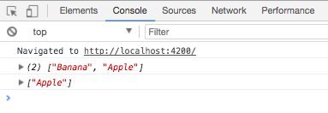
Classes, Spread operator, Arrow function, Immutability
ES5 to ES6 and TypeScript

Slide 25
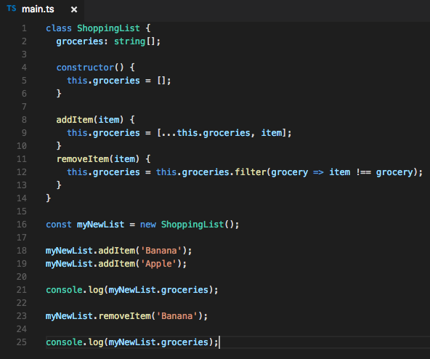
Classes, Spread operator, Arrow function, Immutability
ES5 to ES6 and TypeScript
Notes:
This code would be the equivalent in TypeScript
TypeScript is a superset of ES6 so it supports all functions defined by this standard and provides a more robust and strict syntax to create and lint code.
First we start by creating a new class and add a property called groceries, note that we have to indicate the type, in this case an array of string.
Then, we create the addItem method using ES6 syntax, which TypeScript supports. We use … which is known as “Spread syntax”
For the removeItem we are going to use arrow functions and implicit return

Slide 26
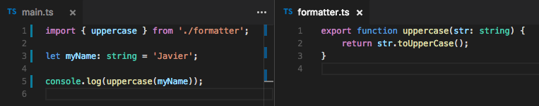
Import & Export
ES5 to ES6 and TypeScript
Notes:
In order to use function defined in other files, we can convert export any function by adding the action “export” before the name. Them, we the action import {} from .. we can include that function into any other file. TypeScript will throw errors if we make any mistake like wrong function name or path when importing.

Slide 27
Installing our project
Getting started
From the folder we have created with Angular CLI run the following commands:
You can also use an alternative to npm called yarn, which is faster and more visual. For it run the following commands on your terminal:
$ npm install
$ ng serve
$ npm install -g yarn
$ yarn install
$ yarn start

Slide 28
Angular cli

Slide 29
Angular cli
Component Architecture and Featured Modules
The Angular CLI is a command-line interface tool that you use to initialize, develop, scaffold, and maintain Angular applications. You can use the tool directly in a command shell, or indirectly through an interactive UI such as Angular Console.
The mainly commands are:
ng generate
ng serve
ng build
ng test
ng e2e
ng lint

Slide 30
Angular cli (ng generate)
Component Architecture and Featured Modules
ng generate generates and/or modify files based on a project. You can generates this files:
Class
Component
Directive
Enum
Guard
Interceptor
Interface
Library
Module
Pipe
Service
ServiceWorker
webWorker
Notes:
Now it’s time to create our first container component and at the same time, refactor our app so it starts to use a proper architecture close to what we should expect from an Angular App. Lets take the following steps one by one.

Slide 31
Angular cli
Component Architecture and Featured Modules
ng build and ng serve build and servers your app. Normally you can put more different options (and arguments) in command-line but it’s recommended to put in angular.json file configuration.
ng lint run linting tools on Angular app code in given project folder. The rules are specified in angular.json or, if you have installed other linting tool, in the specified file (for example tslint.json).
ng test run Unit Tests in a project.
ng e2e run E2E Tests in a project.

Slide 32
Getting started

Slide 33
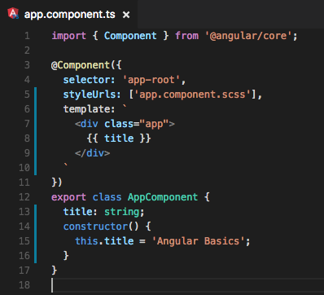
First component with @Component
Getting started
Download the basic css file from here:
https://github.com/jserra91/training-angular/blob/master/style.css
Notes:
First, we open the app.component.ts file and delete all the code as we will create everything from scratch with some minor changes.
We import the component so we can use the decorator.
Then we can export a class that we will call AppComponent, then we’ll see how to use it.
Now we need to declare a new property inside the class called “title” that then we will initialize inside the constructor method.
Now we need to use the @Component function that we imported from @angular/core. @Component is a decorator, decorators are a TypeScript feature that you will allocate before another function or class to add metadata or a “template of values”. Angular will look always for the metadata in order to correctly transpile the code.
Now, we need to define the html. We have two ways to do it, using the param “templateUR”, which I normally recommend for long html files, or use the param template and declare the html code within the component itself. For the second option we need to use the help of the backticks `. This will allow us to concatenate html code in different lines and better readability. For the purpose of the course, we will use this approach.
Please note that we declare a variable called “title” on a TypeScript class that then we use inside the template. We display that value using {{ title }}, that’s called interpolation and we’ll learn it better later but basically {{ }} is an interpolation or a one-way binding between the class and the template. This interpolation executes any expression inside. Now the expression is just a variable but it could be something like this: {{ title + “!” }}.
Finally, we declare the name of the selector “app-root” and the style file that we will use, styleUrls has the same behaviour of templateUrl.

Slide 34
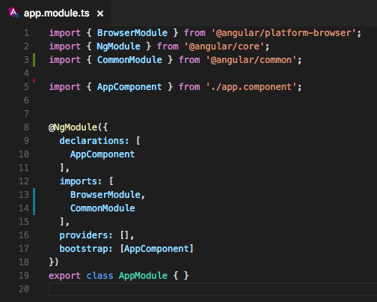
Root module with @NgModule
Getting started
Notes:
Again, open the app.module.ts file and delete the code and start typing this.
We need to import AppComponent to use it here in our module.
Then we try to create the Module, for that we import NgModule from @angular/core, this will bring the @NgModule decorator.
Now we can export the class AppModule and decorate the class.
Now we need to tell Angular to use the AppComponent to bootstrap the App, for that we will use the metadata “bootstrap”. The root Module (in this case the AppModule) is the only Module that will contain the property bootstrap
Then we have declarations where we will import all components we want to use.
Because we want to build a browser application, we need to import the BrowserModule. BrowserModule provides services that are essential to launch and run a browser app. BrowserModule also re-exports CommonModule from @angular/common, which means that components in the AppModulemodule also have access to the Angular directives every app needs, such as NgIf and NgFor.
Do not import BrowserModule in any other module. Feature modules and lazy-loaded modules should import CommonModule instead. They need the common directives. They don't need to re-install the app-wide providers.
BrowserModule throws an error if you try to lazy load a module that imports it. If we are not using a Browser, such a Server side rendering App, we will import a different module.
Importing CommonModule also frees feature modules for use on any target platform, not just browsers. So let’s import it.
To include these modules into our root module we need to use the parameter “import”.
Finally there is another metadata parameter that we will use in the future called providers, there we will import all services.

Slide 35
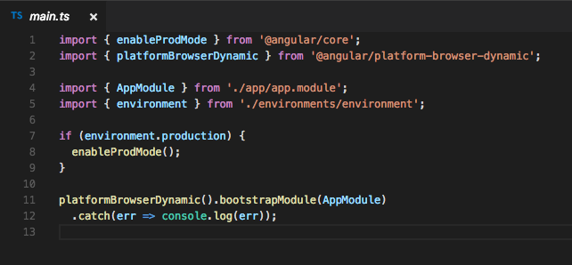
Bootstrapping Angular
Getting started
Notes:
No need to delete the code but let’s look into it.
First we need to import the AppModule so we indicate angular that this module will be our root module.
Now we need to tell angular how to bootstrap this, there are different ways we can use: on the server, on the client or we can pre-compile it, which is an advanced topic. platformBrowserDynamic is for the client rendering option. This provides dependency injection, processes our templates and bindings. This is different from the BrowserModule we used before.
We also import from @angular/core the enableProdMode function, that will disable some assertions and checks that angular does behind the curtains. We also import the environment object to see if we are in production mode or in development mode.
In development mode, change detection does a second run immediately after the first run and produces an error if any bound value has changed between the first and the second run. This helps to locate bugs where checking values has side-effects or fields or functions don't return the same value on subsequent calls which undermines Angular's change detection.
In development mode, during the second change detection run, Angular also does some deep object comparisons that it won't do in production to detect model changes that are disallowed.

Slide 36
Template fundamentals

Slide 37
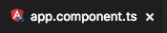
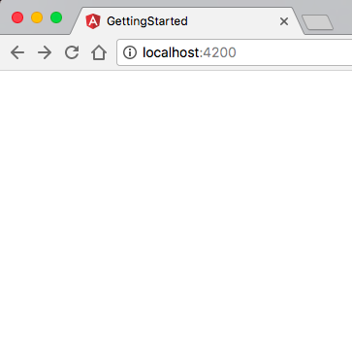
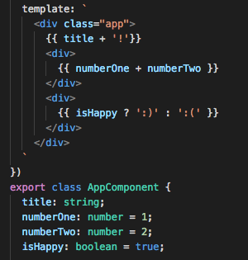
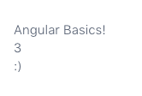
Interpolation & expressions
Template fundamentals
Notes:
We have already explained what is an interpolation and how we use it to bind the value of a TypeScript class into an html template. Now we’re going to see some examples of expressions that can be executed inside the interpolation.
We can see 3 example here:
Concatenate two string and display the result
Sum of 2 numbers (Math expression)
A ternary operator expression
We can see the result at the right

Slide 38
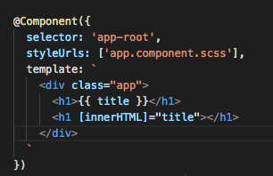
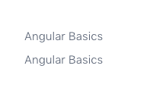
Property binding
Template fundamentals
Notes:
Property binding is how we can pass data from a component class into a template by binding it to a particular element.
The curly braces are something called sugar syntax. It is an easier way to do something that looks cleaner.
Let’s wrap the title with an h1 tag. Sugar syntax will automatically take the value an put it inside the h1. What is really doing is set the innerHTML of the element to the value we pass in.
The equivalent would be something similar to what we have here. Please note that we use brackets notation [] wrapping the innerHTML attribute, that’s the way we can bind an attribute of an element with a variable inside the class. That’s what we call one-way data flow syntax. The data goes from the class to the template and is displayed.

Slide 39
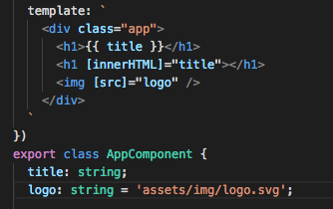
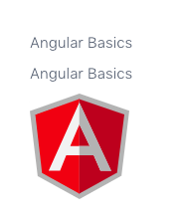
Property binding
Template fundamentals
Download the logo from here:
https://github.com/jserra91/training-angular/blob/master/logo.svg
Notes:
Let’s see now another example. Now we’ll use an image, we declare a property in the class with the path to our new logo and then bind that value to the ”src” attribute of the element <img> by using brackets. Again, this is a one-way binding.
Please note that for the path, as it’s going to be displayed on the html, we take the index.html file as a reference and not the current folder.

Slide 40
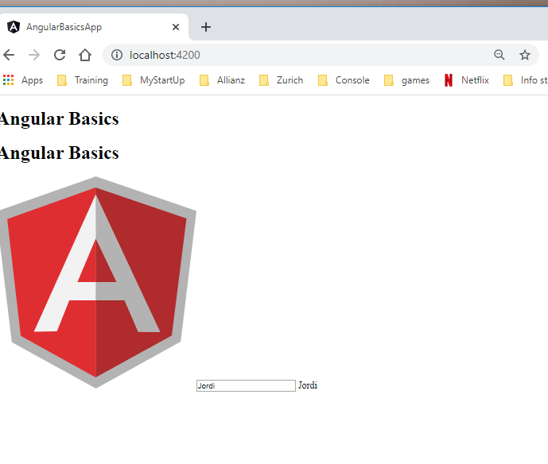
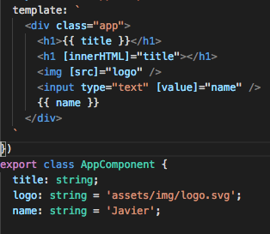
Property binding
Template fundamentals
Notes:
Last example of the one-way binding property will be an input, something that the user can change and modify.
For the input the steps are the same, we want to bind the attribute value of the element <input> to the property name of the class, a property that we’re going to declare and initialize right now.
Please note that the value of the property won’t change even if the user interacts with the input, this is a one-way binding. To demonstrate this, we will display the name as well and check out the result

Slide 41
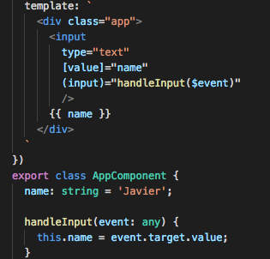
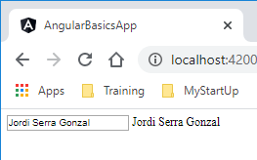
Event binding
Template fundamentals
Notes:
Now that we know how to pass data from the class to the template, we need to learn how to walk that path in the other direction. For that, we’re going to learn event binding. Let’s keep the input element and get rid of the rest of elements we used in the previous examples.
The first thing we will want to do is to update the name that we initially displayed while the user is typing inside the <input> element. For that we are going to use the same technique that we used with property binding but instead of square brackets [], we will use normal brackets (). Elements have many pre-defined events as blur, input, change, etc… let’s start listening to the event input. Every time this event is thrown we will call a new method in our class called handleInput($event) where the parameter $event is the object that is thrown out by the <input> element. The only thing will do in the method will be update the property “name”, this change will automatically change the name displayed because it’s at the same time bound to the value attribute of the element <input>.
Please note that the event that we receive at the handleInput() method contains multiple values and we will only take what is inside event.target.value

Slide 42
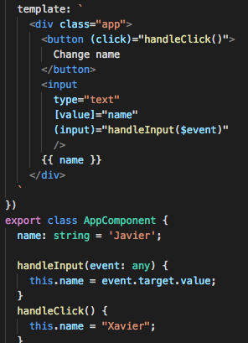
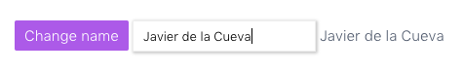
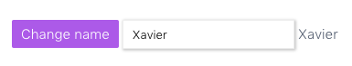
Event binding
Template fundamentals
Notes:
Another common situation will be trigger the event through a button. So let’s implement this option. In this case the event (click) will call a method called handleClick without passing in any object. The method will reset the property name that will spread through all other elements in the html DOM.
This is quite close to a two-way binding but in fact, it is not. It’s just a one-way binding combined with an event binding.

Slide 43
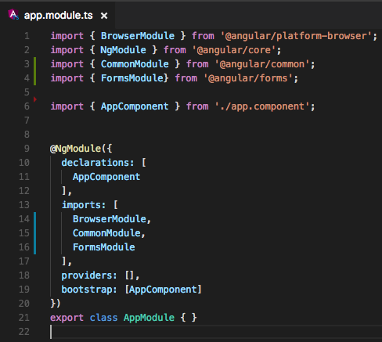
Two-way databinding
Template fundamentals
Notes:
We are going to import a new Module called FormsModule that will allow us to do something called two-way databinding. We will see more functionalities of this Module later on.

Slide 44
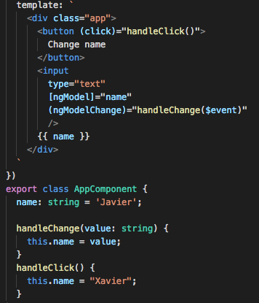
Two-way databinding
Template fundamentals
Notes:
As we see in the code, we’ve made some changes. What we are going to use is a new directive call ngModel. ngModel is a directive that we brought into the component by adding the FormsModule. As we can see the property binding ngModel replaces the [value] and instead of hearing the event (input) we now hear a new event called ngModelChange that will send the value as a string, instead of the whole object.
But still, this is not a two-way binding as we just replaced native events and attributes with a directive.

Slide 45
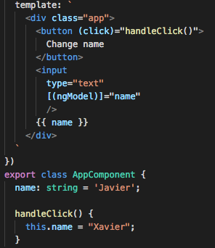
Two-way databinding
Template fundamentals
Notes:
However, we can use ngModel to create an implicit two-way databinding. Just wrapping the event binding with the property binding as it shows the slide, we can get rid of the handleChange event as ngModel will take care of everything for us. Jus use [(ngModel)] and it will do exactly the same but cleaner. ngModel can be use in many other ways but for now, we’ll learn just this want.

Slide 46
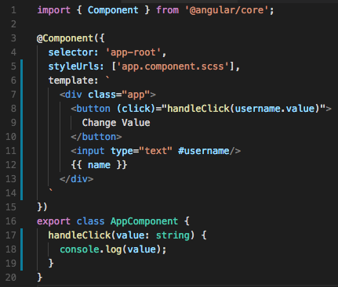
Template #ref variables
Template fundamentals
Notes:
Now we are going to learn another way to pass variables from the template to the class with what we called “template reference”.
We just provide the input with a hashtagged name and then, on the event click in another element, in this case a <button> element, we get the value and pass it over the class.

Slide 47
Rendering flows

Slide 48
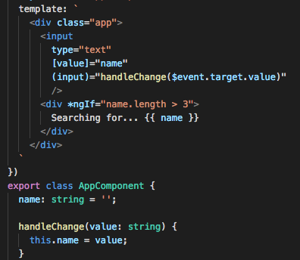
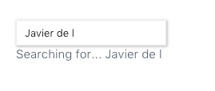
ngIf, * syntax and <template>
Rendering flows
Notes:
ngIf is a directive that we get from importing the CommonModule. We will use it to show/hide something in the template based on a particular expression, for instance, the value of a class property. This is what we call a structural directive.
As we can see now at this new example. We’re using an input with property binning and event binding to handle the content of the value.
In order to display the name, we wrapped up in a new <div> element and added the ngIf directive with an expression. The result is that only when the user has typed 3 characters or more, we will display the result inside the <div> element.

Slide 49
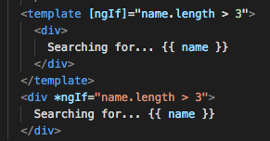
ngIf, * syntax and <template>
Rendering flows
Notes:
But we should not understand this as ”Angular’s Magic” but as some ”under the curtains” transformations that angular does for us. So let’s see what’s really doing angular for us.
ngIf directive uses a new specification called “Web Components”, we do not need to fully understand how web components work but let’s just say that Web components are a set of web platform APIs that allow you to create new custom, reusable, encapsulated HTML tags to use in web pages and web apps. In order for you to create new custom elements in the DOM, Web Components provide you with a new element called <template> that we can use to create elements. <template> tag provides an ability to insert "inert HTML tags" into a document.
So, the * of ngIf is just sugar syntax so we do not have to type the <template> element ourselves. As we can see the ngIf is property bound in the template and this is why we won’t see it in the DOM even if we inspect it.

Slide 50
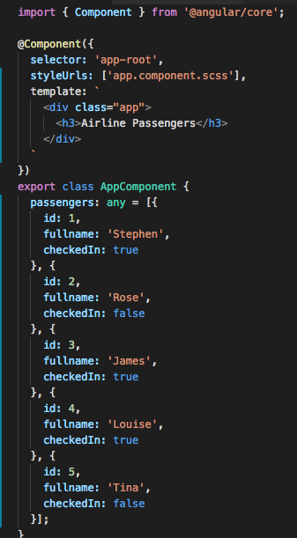
ngFor and iterating collections
Rendering flows
Notes:
Now we’re going to learn about ngFor, similar to how ngIf works, we will use some templates as well but for now, let’s change the content of all app.component.ts to look like the one in the slide. Basically we’ve created a list of passengers in our class and the goal will be to render them out at the template.

Slide 51
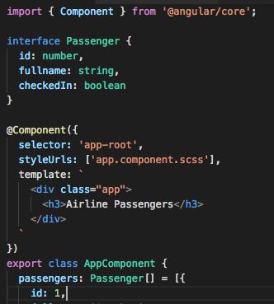
ngFor and iterating collections
Rendering flows
Notes:
We can see the list has a type “any”, so we’re going to learn something new about TypeScript, which are interfaces. We can just use any or even remove the typing but ideally we will define a model or interface where we will specify the params and types of my new object, in this case called Passengers, and declare a list of Passengers instead. This will help with objects and underline errors as we make them.

Slide 52
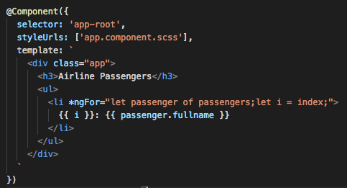
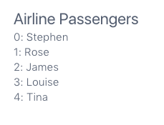
ngFor and iterating collections
Rendering flows
Notes:
The first we want to do is display the passengers of the list, for that we will created a <ul> element. For that we will use the directive ngFor.
Let passenger of passengers is ES6 for loop syntax that will create a new variable called passenger for each iteration. Inside the <li> element we can use that variable, which in our case is an object with three params: if, fullname and chekcedIn. So in order to print out the name we use passenger.fullname.
We also want to show an index so we create a new variable called i that we display along with the name.
The result is shown at the right of the slide.

Slide 53
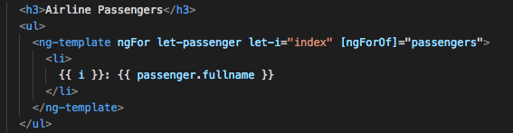
ngFor and iterating collections
Rendering flows
Notes:
And now we can see the what really angular is doing. In this case instead of <template> we use the <ng-template> component added in Angular 4.
We can see the result is the same

Slide 54
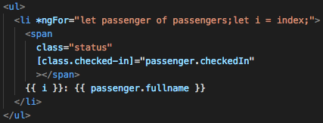
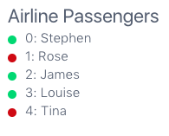
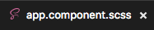
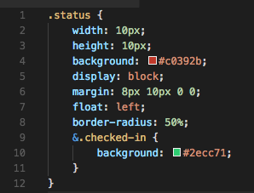
ngClass and className bindings
Rendering flows
Notes:
What we are going to do now is show which passengers are checked in and which ones are not. For that we will first change our app.component.scss file. If you css file still has a .css extension instead of .scss, it’s time to change it as we are going to use sass.
So let’s add some nice circles close to the name of the passenger to indicate the status. This should be the style. Please note that we have used &.checked-in, that’s the sass equivalent to .status.checked-in.

Slide 55
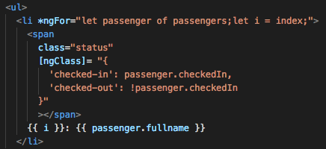
ngClass and className bindings
Rendering flows
Notes:
Although the approach previously explained might be the best approach, there are at least three other ways to do the same
If we want to add more than 1 class, we might want to use the directive ngClass. If we inspect the results, we’ll see that the ones that have not checked in yet will have a class checked-out. In this example we do not have styles for that new class.

Slide 56
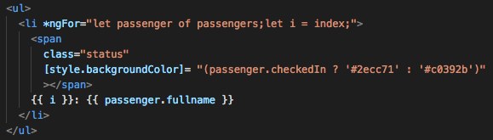
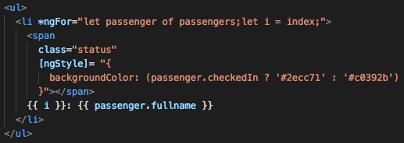
ngStyle and style bindings
Rendering flows
Notes:
Second option is using the property style in the same way we used class before
Third and last option is using the directive ngStyle, similar to ngClass
In general we do recommend to use classes always you can as it helps to change styles in the future just changing a scss files and not having to go through all .ts files to investigate if is there any style inline.

Slide 57
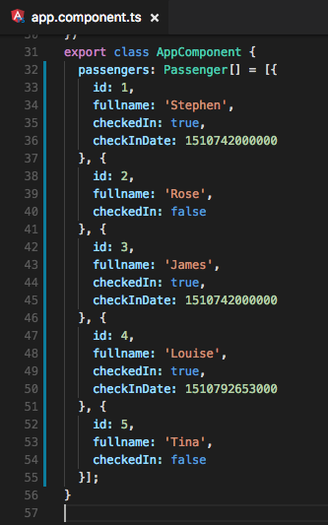
Pipes for data transformation
Rendering flows
Notes:
Now let’s talk about Pipes. They do not have to be complicated as we can thing about them as a function that return something new.
For this example we will add a new parameter to the Passenger class called checkInDate, this parameter won’t exist if the passenger has not checked in

Slide 58
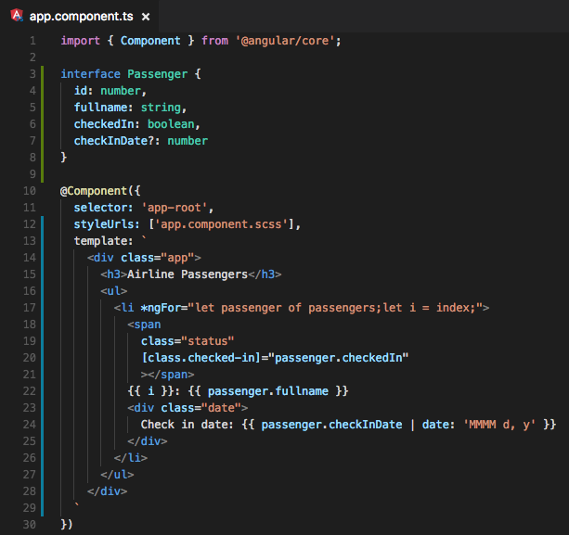
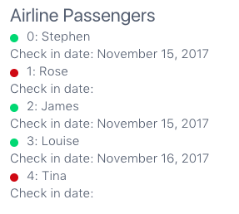
Pipes for data transformation
Rendering flows
Notes:
We will use the ? after the name of the parameter in our interface and use a pre-built pipe that angular provides called “date”

Slide 59
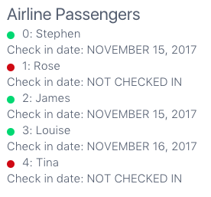
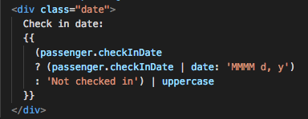
Pipes for data transformation
Rendering flows
Notes:
We can also use ternary expressions to make the result more visual and we can concatenate pipes, as we do here in this example using the pipe ”uppercase”

Slide 60
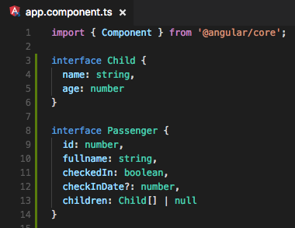
Safe navigation operator
Rendering flows
Notes:
As a last example for the rendering flows section. We are going to learn how to use the save navigation operator. Assume each passenger might or might not have children, let’s add that new parameter to the Passenger interface and create new one for Child. Please note that for children we use “ | null” at the end, that means that if there is no value, the value will accept nulls. The difference between the 2 ways of doing that is that in this way, the value needs to exists, even if it’s null.

Slide 61
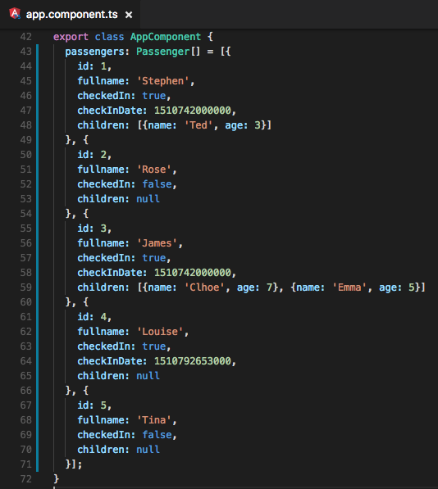
Safe navigation operator
Rendering flows
Notes:
We change our array as well adding some children.

Slide 62
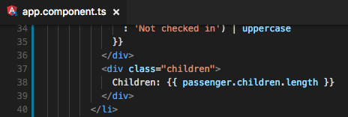
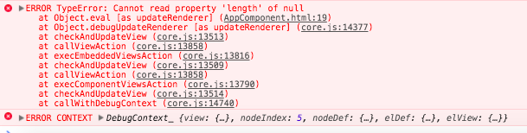
Safe navigation operator
Rendering flows
Notes:
Now we add the length of the children property in order to display but we face an error. Some of these properties are null and that’s fine as we stated in our interface that the value will be “Child[] | null”. In order to avoid this errors we need to use the “Safe navigation operator” which is as simple as adding a ? before the property inside the expression.

Slide 63


Safe navigation operator
Rendering flows
Notes:
Note that just adding ?.length avoids the error to be thrown. We’ve also added a logic operator || to display 0 when there is no child

Slide 64
Exercises
Refresher Exercise
1. We need the ability to filter the list by checked in passengers and not checked in passengers. Add 3 buttons to the App, one to see only checked-in passengers, one to see not checked-in passengers and one to see all.
2. We want to know the nationality of each passenger. For that we will add a flag before the name of the passenger. Please take in consideration that this information is not mandatory for them so we need to assume that passenger won’t provide that information.
3. We want a prettier list so we need to wrap each item of the list with a card.
Download flags from here: https://github.com/jserra91/training-angular/blob/master/flags.zip

Slide 65

Results
Refresher Exercise

Slide 66

Results
Refresher Exercise

Slide 67

Results
Refresher Exercise

Slide 68
Component Architecture
&
Featured Modules

Slide 69
Smart and Dumb components overview
Component Architecture and Featured Modules
Container / Smart / Stateful
<>
Communicate with services
Render child components
<>
Service
<>
Smart / Container Component
<>
Presentational / Dumb /stateless
<>
<>
Component
Component
<>
Accept data via inputs
Emit data changes via event outputs
<>
<>
Component
Component
Notes:
If the component has a service or something to obtain data from the backend, it becomes a smart component while the others, do not need to know where the data comes from so they are known as Dumb Components.

Slide 70
One-way data overview
Component Architecture and Featured Modules
<>
Service
<>
<>
<>
<>
<>
Notes:
Imagine that the service calls an http rest server and gets back some data. He passes down that data.

Slide 71
One-way data overview
Component Architecture and Featured Modules
<>
Service
<>
<>
<>
<>
<>
Change
Notes:
Now we assume that the user makes a change, click a button, type something inside an input. Now we might have to update this data up to the main component and send it over the server using an http request.

Slide 72
One-way data overview
Component Architecture and Featured Modules
<>
Service
<>
<>
<>
<>
<>
Change
Notes:
We do this through something called events, angular has something called event emitter. Now we have to send that information, that’s a one-way data binding and not a two-way data binding.

Slide 73
One-way data overview
Component Architecture and Featured Modules
<>
Service
<>
<>
<>
<>
<>
Data flows down
Event emits up
Notes:
If the main component now has to send down this data to other components, this will be the flow

Slide 74

Feature modules with @NgModule
Component Architecture and Featured Modules
Notes:
Now it’s time to build a custom module creating a custom NgModule. For that we’re going to create a new folder called “passenger-dashboard” inside “app” folder and we’re going to create a new file called passenger-dashboard.module.ts
We don’t want everything to live in AppModule because we will have too many imports and it becomes hard to use different modules across different applications. So the idea is all of the logic for our passenger-dashboard will live inside the PassengerDashboardModule. This allows us to take this module as it is and paste it into another application and it should work without doing anything else.

Slide 75

Feature modules with @NgModule
Component Architecture and Featured Modules
Notes:
Let’s create our custom module. We need to import NgModule from @angular/core as we did before in our AppModule. Now we have the @NgModule available so let’s create a normal class called PassengerDashboardModule (Camel Case from the file name) and then add the decorator before.
We need to add here everything our PassengerDashboard is going to need. For now we add an empty declarations array that we will fill up with all components we want to use in this module.
As we want this module to be independent and portable, one thing that we’ll need as well is the CommonModule to use ngIf, ngFor, etc…

Slide 76

Feature modules with @NgModule
Component Architecture and Featured Modules
Notes:
We do not want to add thousands of components to our AppModule in order to use them, this is why we wrap them all with a module, in this case the PassengerDashboardModule. The only thing we have left to do is add the new module to our AppModule.
We’ve created our first featured/custom module and added to our main module.
At some point we could split the modules in custom modules and angular modules.

Slide 77
Creating a container (smart) component
Component Architecture and Featured Modules
Inside src/app/passenger-dashboard/ folder we create another folder called “container”.
Inside the last folder, we create a passenger-dashboard component (ng generate component passenger-dashboard/container/passenger-bashboard)
Inside src/app/passenger-dashboard/ create a folder called “models” and create a passenger interface (ng generate interface passenger-dashboard/models/passenger).
Cut all the data we have inside the template property of AppComponent to passenger-dashboard.html
Copy all the content of the class AppComponent into the new class created called PassengerDashboardComponent and import the new interface.
Copy all the content from app.component.scss to passenger-dashboard.component.scss
Import the PassengerDashboardComponent into our PassengerDashboardModule
Add the new selector created into our AppComponent template
Notes:
Now it’s time to create our first container component and at the same time, refactor our app so it starts to use a proper architecture close to what we should expect from an Angular App. Lets take the following steps one by one.

Slide 78

Creating a container (smart) component
Component Architecture and Featured Modules
Inside src/app/passenger-dashboard/ folder we create another folder called “containers”.
Inside the last folder, we create a passenger-dashboard component (ng generate component passenger-dashboard/containers/passenger-bashboard)

Slide 79


Creating a container (smart) component
Component Architecture and Featured Modules
3. Inside src/app/passenger-dashboard/ create a folder called “models” and create a passenger interface (ng generate interface passenger-dashboard/models/passenger).
Notes:
We have to export both interfaces so we can use them from any other place. In our case we have to import our Passenger interface in our new component passenger-dashboard.component.ts

Slide 80

Creating a container (smart) component
Component Architecture and Featured Modules
Cut all the data we have inside the template property of AppComponent to passenger-dashboard.html
Notes:
Now it’s time to create our first container component and at the same time, refactor our app so it starts to use a proper architecture close to what we should expect from an Angular App. Lets take the following steps one by one.

Slide 81

Creating a container (smart) component
Component Architecture and Featured Modules
Copy all the content of the class AppComponent into the new class created called PassengerDashboardComponent and import the new interface

Slide 82


Creating a container (smart) component
Component Architecture and Featured Modules
Copy all the content from app.component.scss to passenger-dashboard.component.scss
Notes:
Now all style we’ll apply to our component but please note that in angular, all styles are encapsulated. What that means is that angular will add a special class with a random text that will make it unique, so it makes sure the styles in our css only apply to our component.
In this case “-c1” is a random appendix added to the class_ngcontent. Everytime we refresh the page that value will change.

Slide 83

Creating a container (smart) component
Component Architecture and Featured Modules
Import the PassengerDashboardComponent into our PassengerDashboardModule
Notes:
We import the component and add it to our declarations property. Now, our PassengerDashboardModule is linked to our PassengerDashboardComponent but if we import our module into any other module, we won’t be able to use the new created component. The reason for that is because we have created an isolated environment for all our PassengerDashboard code, if we want to allow other modules to use something in this envitonment, we need to explicitly export it. So let’s add our PassengerDashboardComponent to our ”exports” property.

Slide 84

Creating a container (smart) component
Component Architecture and Featured Modules
Add the new selector created into our AppComponent template
Notes:
We have re-ordered everything but there are two small things left to do. We’ve moved almost all the code to a new isolated component with a module that manages all dependencies, its own sass file, html file and component file. But we still want to show our fancy component in our page, for that, we’ll have change the AppComponent class to use the new selector we’ve created.

Slide 85

Creating a container (smart) component
Component Architecture and Featured Modules
Notes:
And this should be the result. Check it out!

Slide 86

ngOnInit lifecycle hook
Component Architecture and Featured Modules
Notes:
A lifecycle hook is a function that is called by angular when something happens. The OnInit lifecycle hook is when the component is initialized. At the moment, in our PassegnerDashboardComponent we’re initializing some static data, when we’re actually come to implementing dynamic data, we’ll need this behaviour done inside the OnInit lifecycle hook. This is an important step so you fetch your data when your component is ready and not before.
So what we’re going to do now is implement the OnInit lifecycle in our class. First we import the OnInit interface and then we make our class implements that interface. Once we’ve done this we’ll see an error in our class forcing us to implement the property ngOnInit, so let’s do it so. The fact that this property is prefixed with “ng” means that Angular is controlling this function.
We’ll move the initialization of our passengers property to the ngOnInit function and check out the results, everything should be working as before.

Slide 87

Lifecycle hook
Component Architecture and Featured Modules
A component has a lifecycle managed by Angular.
Angular creates and renders components along with their children, checks when their data-bound properties change, and destroys them before removing them from the DOM.
Angular offers lifecycle hooks that provide visibility into these key life moments and the ability to act when they occur.
A directive has the same set of lifecycle hooks.
Notes:
ngOnChanges is executed at the first time after the constructor or when resets data-bound input properties.
ngOnInit is execute only one time when the component is creating.
ngDoCheck is executed always then ngOnchanges or ngOnInit.
ngAfterContentInit is executed after childs components are executed (in TS).
ngAfterContentChecked is executed after childs components are projected (in TS).
ngAfterViewInit is executed after childs components are executed (in HTML).
ngAfterViewChecked is executed after childs components are projected (in HTML).
ngOnDestroy is executed before when Angular destroy the directive/component.

Slide 88

Presentational (dumb) components
Component Architecture and Featured Modules
Notes:
One of the fundamental attributes of a container components is that contains things such as data and renders stateless child components. Our Components for now has a lot of data but it’s not rendering any child. Let’s then created a stateless child component and then we’ll learn how to pass in data.
Let’s create three new components:
passenger-count
passenger-actions
passenger-detail

Slide 89


Presentational (dumb) components
Component Architecture and Featured Modules
Notes:
Now we need to create another folder called “components” where we will place all this stateless or presentational components. In this way we can have a clear separation between container and presentational components. Inside each component we will create a new class.

Slide 90

Presentational (dumb) components
Component Architecture and Featured Modules
Notes:
This is how will look like our PassengerActionsComponent

Slide 91

Presentational (dumb) components
Component Architecture and Featured Modules
Notes:
This is how will look like our PassengerCountComponent

Slide 92

Presentational (dumb) components
Component Architecture and Featured Modules
Notes:
This is how will look like our PassengerDetailComponent

Slide 93

Presentational (dumb) components
Component Architecture and Featured Modules
Notes:
Now we have to import these new classes to our PassengerDashboardModule in order to allow the PassengerDashboardComponent to use them.
If we want, we can add some comments in order to differentiate between containers and presentational components.
Note that we do not have to export the rest of the components because outside this module, the only component that is being used is the PassengerDashboardComponent. The rest of components are referred internally.

Slide 94

Presentational (dumb) components
Component Architecture and Featured Modules
Notes:
If we’ve done everything correctly, our App should look like this

Slide 95


Passing data into components with @Input
Component Architecture and Featured Modules
Notes:
What we’re going to do now is bind some properties to our new components so we can start pass in data. We need to move the html code to our new templates.
Let’s start with the PassengerActionsComponent first. We’ll copy the html code into the template property and also copy the function filterPassengers() and the “display”.
This is how will look like. However, we’ve lost the functionality of our filters. That’s OK for now, and we’ll fixed in a moment.
This was easy as this is not expecting any data, but let’s try the PassengerCountComponent

Slide 96

Passing data into components with @Input
Component Architecture and Featured Modules
Notes:
As we learnt previously, we’re going to use the property binding of angular to pass data into a child component. This is similar to what we did with the <input> element:
<input [value]=“name”>
With this, we’re binding the property “passengers” generated on the class PassengerDashboardComponent to the child component PassengerCountComponent.
Now we need to learn the PassengerCountComponent to handle this parameter. Let’s see how.

Slide 97


Passing data into components with @Input
Component Architecture and Featured Modules
Notes:
First of all, we need to declare a new property called items and we tell them that it’s going to be the type Passenger[]. We’ll see an error telling that the component does not know that type, so we’ll have to import the interface again as we see in line 3.
Then, we need to tell Angular that this new property is going to be an input or a parameter that is going to receive our component. For that we import the class Input from @angular/core, this will bring the decorator @Input() to our PassengerCountComponent. By adding the decorator before the property ”items” we are already telling angular this is an input and the property binding we implement before will work now. This work like the @Component() decorator.
Finally, to show the items has correctly arrived to our component let’s change the template as you can see in this slide and add the expression items.length to show the number of passengers

Slide 98


Passing data into components with @Input
Component Architecture and Featured Modules
Notes:
Now that we have learnt how to pass data to our child component, let’s go a bit further with this and implement some methods in our component. What we really want to see in our App is not the total number of passenger but also how many of them have checked in already. Let’s create a new method that gives back that number and display it in our template.
First we’ll check if this.items exists, if not, we’ll just hit return so the method does not fail. If this.items does exist, we’ll just filter the array and return just the passengers who have the property checkedIn equal true. Finally we’ll return the length of this filtered array.
See the result now in the browser.

Slide 99

Passing data into components with @Input
Component Architecture and Featured Modules
Notes:
As a last comment, let’s try to make our checkedInCount function cleaner and shorter by making the filter a shorthand arrow function. This is how will look like now.

Slide 100

Dynamic @Input values for *ngFor
Component Architecture and Featured Modules
Notes:
Now we’re going to learn how to implement the ngFor directive inside a custom component instead of doing it in our <li> element. As we are declaring the variable “passenger” inside the element <passenger-detail> we technically can bind it to an input property of that component that we’ll called “detail”. Let’s see how it would look like the html in passenger-dashboard.component.html and then we’ll go to declare the input in the new class.

Slide 101

Dynamic @Input values for *ngFor
Component Architecture and Featured Modules
Notes:
First let’s copy all the code inside the <li> element from the file passenger-dashboard.component.html and paste it into our template.
Let’s make some changes, we can get rid of the {{ i }} interpolation.
We need to change the property ”passenger” by “detail” as that’s the name we gave it in our component.
We need to declare again the properties display and defaultFlag so let’s just copy them from the PassengerDashboardComponent.
Now that we’re here, let’s change some elements in our html so everything looks better.

Slide 102

Dynamic @Input values for *ngFor
Component Architecture and Featured Modules
Notes:
Let’s now copy all the styles we had in our passenger-dashboard.component.scss file to our new passenger-detail.component.scss file

Slide 103


Dynamic @Input values for *ngFor
Component Architecture and Featured Modules
Notes:
If we’ve done everything OK, this should be the how the passenger-dashboard.component.html file would look like and the result in the browser.

Slide 104

Emitting changes with @Output and EventEmitter
Component Architecture and Featured Modules
Notes:
We’re now going to learn how to send data up from a child component to a parent component. For that let’s create some new actions into our detail component. Let’s implement all necessary code to add 2 new buttons to each card, ”Edit” & “Remove”.
As the html code is starting to get bigger again, let’s create a new file called passenger-detail.component.html and leave the template logic there.
Before starting with the class, let’s add some new buttons to the template and a bit of logic. We first add a new div with a class called “passenger-detail-actions” and 2 buttons. One to Edit and one to remove. These 2 buttons will trigger an event on click and called 2 different function that will handle the event, we’ll see in a minute those functions.
We’ll declare a property inside the class called “editing” that will tell us if we are editing a name or we’ve already finished editing. Depending on that value we’ll show the plain name with the flag or an input that will allow users to change the name. Check out that logic on line 17 and 25.
Finally, we’ll switch the name of the Edit input to “Done” and “Edit”, depending on the value of the property “editing”

Slide 105

Emitting changes with @Output and EventEmitter
Component Architecture and Featured Modules
Notes:
First thing we have to do in our class is importing two more classes to our component from @angular/core: Output and EventEmitter. Every time we want to send data out of a component we will need them both.
@Output is another decorator that will indicate the component that this property is going to output some data out of it. The EventEmitter will work similar to a normal JavaScript event and will send an event through that property in a way that parent components can subscribe to that event and start listening.
The way to use it is similar to what we did with the event (click) from an element <input>, we’re going to define our custom event so other components can subscribe to it.
Note that we have added 2 more properties: remove and editing. We have decorated with an @Output both of them and used the type EventEmitter = new EventEmitter(). With this we’re declaring our events and the only thing we have to do is emit information through them.
Then declare the property “editing”, as we said before, this will be a boolean that will change value depending on what we’re doing.
Now we define all methods to handle the actions and emit our code.

Slide 106


Emitting changes with @Output and EventEmitter
Component Architecture and Featured Modules
Notes:
Finally, we need to change the passenger-dashboard.component.html file to listening to those new events and call some methods to handle them.
For now, we’ll only console.log the event and then, we’ll so how we manage them.

Slide 107



Emitting changes with @Output and EventEmitter
Component Architecture and Featured Modules
Notes:
This should be the result in the browser

Slide 108



Immutable state changes
Component Architecture and Featured Modules
Immutable
Mutable
Notes:
We have implemented here the logic for both methods that were handling events but before explain that, let’s stop for a second a talked about something we’ve been doing trhoughout the course: Immutability.
First of all, why is immutability important?
Well, mutating data can produce code that’s hard to read and error prone. For primitive values (like numbers and strings), it is pretty easy to write ‘immutable’ code, because primitive values cannot be mutated themselves. Variables containing primitive types always point to the actual value. If you pass it to another variable, the other variable get’s a fresh copy of that value.
Objects and arrays are a different story, they are passed by reference. This means that if you would pass an object to another variable, they will both refer to the same object. If you would then mutate the object from either variable, they will both reflect the changes.
Example:
Can you see the problem here? When we change newObj, we also automatically change the old obj variable. This is because they refer to the same object. In most cases this is unwanted behaviour and bad practice. Let’s see how we can solve this.
Instead of passing the object and mutating it, we will be better off creating a completely new object:
Object.assign is an ES6 feature that takes objects as parameters. It will merge all objects you pass it into the first one. You are probably wondering why the first parameter is an empty object {}. If the first parameter would be ‘person’ we would still mutate person. If it would be { age: 30 }, we’d overwrite 30 with 28 again because that would be coming after. This solution works, we kept person intact, we treated it as immutable!
However, EcmaScript actually has a special syntax that enables us to do this even more easily. It’s called object spread and and It looks as follows:
What about performance?
You might think that this would yield terrible performance, and in some ways you’d be right. Whenever you add something to an immutable object, we need to create a new instance by copying the existing values and add the new value to it. This will certainly be both more memory intensive and more computationally challenging than mutating a single object.
Because immutable objects never change, they can be implemented using a strategy called “structural sharing”, which yields much less memory overhead than you might expect. There will still be an overhead compared to built-in arrays and objects, but it’ll be constant, and can typically be dwarfed by other benefits enabled by immutability. In practice, the use of immutable data will in many cases increase the overall performance of your app, even if certain operations in isolation become more expensive.

Slide 109

Immutable state changes
Component Architecture and Featured Modules
Notes:
Here we can see how we are change the array in an immutable way. Removing the array is as simple as using again the function filter that will return a new created array without the value removed. We update this.passengers and that will spread to the child components.
For editing is almost the same, instead of using filter, we’ll use map, a function that will run a piece of logic for each item in the loop. In this case we’ll use Object.assign to create a new object and assign it to the value passenger, that will be included into the final array that will return. As the result here is not visual, we add a console.log to display the result.
Let’s see the result.

Slide 110
Exercises
Refresher Exercise
1. Implement again the functionality of our filter buttons.
2. Create a new passenger action to manually check in passengers from the list.
3. Create a new presentational component called passenger-info and a new passenger action called “select”. Implement the logic so every time we click select, a new card with the information of the passenger, including the names of the children if they exist, it’s shown.

Slide 111




Results
Refresher Exercise
1. Implement again the functionality of our filter buttons.

Slide 112


Results
Refresher Exercise
2. Create a new passenger action to manually check in passengers from the list.

Slide 113



Results
Refresher Exercise
3. Create a new presentational component called passenger-info and a new passenger action called “select”. Implement the logic so every time we click select, a new card with the information of the passenger, including the names of the children if they exist, it’s shown.

Slide 114

Results
Refresher Exercise
3. Create a new presentational component called passenger-info and a new passenger action called “select”. Implement the logic so every time we click select, a new card with the information of the passenger, including the names of the children if they exist, it’s shown.

Slide 115


Results
Refresher Exercise
3. Create a new presentational component called passenger-info and a new passenger action called “select”. Implement the logic so every time we click select, a new card with the information of the passenger, including the names of the children if they exist, it’s shown.

Slide 116


Results
Refresher Exercise
3. Create a new presentational component called passenger-info and a new passenger action called “select”. Implement the logic so every time we click select, a new card with the information of the passenger, including the names of the children if they exist, it’s shown.

Slide 117
Services, http & Observables

Slide 118

Data services and dependency Injection
Services, Http and Observables
Notes:
Now we’re going to learn how to load some live data. For now what we’re doing is referencing a static array. Let’s start changing that so we start calling an API to fetch our data.
First of all, we need to create a service. As we explained at the beginning of the course, services will be responsible for fetching data and pass it to the components (among other responsibilities)
We create a file called “passenger-dashboard.service.ts” and we leave it at the same level of our ”passenger-dashboard.module.ts”
We will create a method to fetch the data, for now we’ll only copy the passengers array from our PassengerDashboardComponent and past it to a new method called getPassengers that will synchronously return the same data. We type the result as an array of Passengers and for that, we import the interface. In a few moments we’ll change this method to be asynchronous but for now, let’s leave it like this.
The idea here is to create a data layer for our component.

Slide 119

Data services and dependency Injection
Services, Http and Observables
Notes:
Now we need to import this service into our passenger-dashboard.module.ts file and add it to our @NgModule. For that we’re going to use a new property called providers. We’ll explain this deeply in the next slide where we will introduce the Dependency Injection concept.

Slide 120

Data services and dependency Injection
Services, Http and Observables
Notes:
What we can see here is we are importing again the new service into our component and then, we’re injecting it in the constructor so we can finally use it inside our onInit method.
What we are doing in the constructor is what we called Dependency Injection, basically we’re injecting a dependency to the component, in this case from a service. That means that the component won’t be able to work properly without the service.
At line 18 we can see:
constructor(private passengerService: PassengerDashboardService) {}
This is a TypeScript equivalent to
private passengerService;
constructor(PassengerDashboardService) {
this. passengerService = PassengerDashboardService;
}
Without many details, this is how it works. We declare the providers we’re going to use along the Component in our Module, this will create a list of providers or injectors that will inject services into components when asked. If the injector does not exist because it’s the first time we call it, it will go and look for it, otherwise, it will use it.
Then, we have to inject the services into our components as we’ve seen before and Angular will go to it’s list of providers and look for the proper injector to add the code into the class.

Slide 121

Understanding @Injectable
Services, Http and Observables
Notes:
We need to change the getPassengers method to fetch data from an API through an http request. For that we need to slightly change our service. First we need to import into our Module a new module called HttpClientModule that will provide all the code needed to perform http requests.

Slide 122

Understanding @Injectable
Services, Http and Observables
Notes:
Here we import a new class called Http that will allow us to perform http requests but in order to use it, we need to inject it into our service class. Note that in this case we’re using the decorator @Injectable. We’re telling Angular that we can inject things into the class constructor.
It might be a good practice to mark all services as Injectable even if we’re not going to inject anything.
Please note that we do not have to mark our Component as @Injectable because by default, all @Components and @Directives are injectable.

Slide 123

Http data fetching with Observables
Services, Http and Observables
We are going to install the npm json-server module and then run it from our project folder specifying the .json file we want to use:
Please note that we install the module globally (-g), otherwise the command line json-server won’t work.
Now, to make things easier, we’ll change our package.json file to add a new script to start our server.
$ npm install -g json-server
$ json-server --watch db.json
Notes:
Now we’re going to finally called an http server to fetch our data but the problem now is, we do not have a server implemented. Luckily for us, we have many options available to work around this situation. What we’re going to use is a npm module called json-server. This module will create an http server from a .json file. So let’s quickly see how can we install it in our system.

Slide 124
Http data fetching with Observables
Services, Http and Observables
Now, we will open a new terminal tab and run the follwing command:
And we will have our server up and running.
$ npm json-server
or
$ yarn json-server

Slide 125

Http data fetching with Observables
Services, Http and Observables
Download this file from here: https://github.com/jserra91/training-angular/blob/master/db.json
Notes:
Now we have to move the array we’re returning in our getPassengers() function to the db.json file. The result should be something like this.

Slide 126

Http data fetching with Observables
Services, Http and Observables
Notes:
Finally, we’re going to use our environments variables to store the url of our new server, as we would do with a real server. For now, we’re going to add it just to the environment.ts file, we would need another property for this in our environment.prod.ts file

Slide 127

Http data fetching with Observables
Services, Http and Observables
Notes:
Let’s implement now http calls from our service. We can clearly see some changes, there are more imports at the beginning of the file but the class it’s clearly smaller than before.
We have imported the environment file and created a constant called PASSENGER_API that we will use to call our backend
We have imported the class Observable from the rxjs class. This is because http returns an object of type Observable, we had to import that new object and change the type of the response in our method getPassengers. Then, convert the result to a json object. Automatically is mapped to Observable JSON value.

Slide 128


Http data fetching with Observables
Services, Http and Observables
Notes:
We’ve also change the way we were calling the getPassengers method. As this is now an asynchronous function, we can not expect to handle the result as we did before, instead we need to subscribe to the result and handle the data when the subscribe function is called. Basically the Observable performs an action that does not end at that moment, when it gets the results, it calls the method subscribe so we can handle the data again.
Now we can see there is an error in the console. This is why we previously learnt to use safe navigation operation because when we make asynchronous requests, things that we reference in our template might not be available. We need to change the passenger-count template to use the safe navigation operator.

Slide 129

Http put, delete with immutable state
Services, Http and Observables
Notes:
Let’s now implement two more methods, put and delete.
For that, we’re going to create 2 new methods called updatePassenger and removePassenger. Both will call the API and we will use http.put and http.delete. Please nota that the http.put function requires a second parameter, which is in fact the object we want to update. Please also note that we are using the same URL than before but concatenating the passenger.id. Finally in both cases, the type of the result will be a Passenger and not a Passenger[].
The rest of the code is the exact same syntax we use in our getPassenger method. We use an Observable, we map over the result to convert it to a json object and return it to whoever is subscribed to the Observable, in this case, the component.

Slide 130

Http put, delete with immutable state
Services, Http and Observables
Notes:
Finally we will implement the logic in our component.
Please note that after doing our tests, the db.json file will be changed. Our recommendation is to backup the file before start testing your new code. To do so you have 2 options, manually copy the json file or go to the terminal where your json-server is up and running and press ‘s’ and hit ’enter’, this will create a backup of your file.
Now if we check out the code, we’ll see the same syntax is repeated. We call our service method and subscribe to the observable. When the observable sends the data, we perform the exact same logic we had before. The only difference is that now, we need to wait the result of the http request, which will be done asynchronously.

Slide 131

Custom Headers and RequestOptions
Services, Http and Observables
Notes:
Right now we’re working with a simple server but in real life, we’ll probably need to change the http request headers in order to specify a Content-type or add a new header for Authentication. We are going to show how to do this in our code although if we really need to change the headers, it will probably be a better idea to create a service that performs these actions and warp the http requests, instead of doing it on each method, as we show in this example.
First we’ll need to import “HttpHeaders” from @angular/common/http. Then we can create a header, insert that header into a RequestOption append that to our request using the last optional parameter of the http functions.

Slide 132


Http Promises alternative
Services, Http and Observables
Notes:
As an alternative to Observables, we can use Promises. Instead of importing the operator “map”, we import the operator “toPromise” and then we change our code as we show here to support promises. Then in our component, instead of “subscribe” to the result, we simply use then() to handle the response. The rest of the code does not change.
When should we use an Observable and when a Promise? Short answer is this:
A Promise represents just one future value
An Observable represents the possibility of an infinite number of values.
We’ll see it clearly with 2 examples:
- Promise: Ajax response
- Observable: Event click.
By default Angular uses Observable but we do recommend to use both Promises and Observables, depending on the logic. For the purpose of this course, we’ll keep using Observables.

Slide 133

Observable.catch error handling
Services, Http and Observables
Notes:
To finish with Observables, we’re going to learn how to manage errors with observables.

Slide 134
Exercises
Refresher Exercise
Implement the create passenger logic:
Create a button to Add Passengers
Create/Reuse a card to fill up new Passenger info
Implement the http call

Slide 135



Results
Refresher Exercise
1. Create a button to Add Passengers

Slide 136


Results
Refresher Exercise
2. Create/Reuse a card to fill up new Passenger info

Slide 137


Results
Refresher Exercise
2. Create/Reuse a card to fill up new Passenger info

Slide 138

Results
Refresher Exercise
2. Create/Reuse a card to fill up new Passenger info

Slide 139


Results
Refresher Exercise
3. Implement the http call

Slide 140

Results
Refresher Exercise
3. Implement the http call

Slide 141
Template-driven Forms,
Inputs and Validation

Slide 142

Forms container component
Template-driven Forms, Inputs and Validation
Notes:
Now we’re going to learn about forms but before that, we need to prepare our application. First we’ll create a new method in our service to allow us to get information from one particular passenger.
We’ll create a new method at our passenger-dashboard.service.ts file very similar to getPassengers(). In this case there is an input called id and the path to the server slightly changes.
This will return the information of one particular passenger.

Slide 143

Forms container component
Template-driven Forms, Inputs and Validation
Notes:
Now we’re going to create a new container called passenger-viewer. There we will place our new form. For it we’ll create a new component and a scss file. We won’t use it for now but we’ll do in the future.
This component we’ll call to the new method with a hardcoded passenger id in order to get the info and display it in the template using the pipe “json”

Slide 144

Forms container component
Template-driven Forms, Inputs and Validation
Notes:
For now we’re going to work just on this container so we’ll switch the component to be loaded in app.component.ts file from <passenger-dashboard> to <passenger-viewer>

Slide 145

Forms container component
Template-driven Forms, Inputs and Validation
Notes:
And finally add the new component to our passenger.module and export it so it can be used from outside.

Slide 146


Forms container component
Template-driven Forms, Inputs and Validation
Notes:
And this will be the result

Slide 147


Forms stateless component
Template-driven Forms, Inputs and Validation
Notes:
Now we’re going to add a new property to our Passenger interface and to our db.json server as well called “baggage”. It will be optional just to not break something.

Slide 148


Forms stateless component
Template-driven Forms, Inputs and Validation
Notes:
We’ll now create a new stateless component called passenger-form. For now we’ll only show the passenger information and won’t use the scss file.

Slide 149

Forms stateless component
Template-driven Forms, Inputs and Validation
Notes:
As we’re going to use “Forms” we need to import “FormsModule” at our PassengerModule as well as importing the new component. If we followed all the exercises we might have already imported it but if not, now it’s the time to do it.

Slide 150

Forms stateless component
Template-driven Forms, Inputs and Validation
Notes:
Finally we need to call our new component from passenger-viewer so we change it like this

Slide 151

Forms stateless component
Template-driven Forms, Inputs and Validation
Notes:
And this will be the result.

Slide 152

ngForm and ngModel
Template-driven Forms, Inputs and Validation
Notes:
Now we’re going to learn how ngForm and ngModel works inside a form element in angular.
First we will start by setting up a template reference (as we saw previously in this tutorial). This will export ngForm, which is an angular directive that works under the hood to keep track of all of the state changes and all the validation over our inputs inside our form. We also have to used an attribute called “novalidate” so we can use built-in angular validations.
Because this is a template-driven form each input needs to have a name. Each name will create a property on the form as an object. In this case, ngForm is assigned to the object called “form” so all changes will be seen inside “form.value”

Slide 153

ngForm and ngModel
Template-driven Forms, Inputs and Validation
Notes:
We can see the two different values although nothing is changing yet

Slide 154

ngForm and ngModel
Template-driven Forms, Inputs and Validation
Notes:
Just by adding ngModel to the element, we will tell ngForm to bind this value to the “form” object and now, we’ll see all changes.

Slide 155

ngForm and ngModel
Template-driven Forms, Inputs and Validation
Notes:
This is the result. Now you might think you have to go back and update the “detail” object but no. Because we’re using template driven forms, the template is the source of truth

Slide 156

ngForm and ngModel
Template-driven Forms, Inputs and Validation
Notes:
Now let’s see how we can initialize this input. For that we add the brackets around ngModel and initialize with detail?.fullname. Two things to note here:
- Brackets are always used to send information to components or directives by binding a value to a property, in this case ngModel is the property.
We use the ? Because the data might not be available at first.
We add another example for ID, but this time numeric

Slide 157

ngForm and ngModel
Template-driven Forms, Inputs and Validation

Slide 158

Binding to radio buttons
Template-driven Forms, Inputs and Validation
Notes:
Now we’re going to create two input radio elements. By using the same name property, we make them all be part of the same group. We initialize the two options using detail?.checkedIn and add a value for each one. Please note that if we do not use brackets for value, the value won’t be a boolean and it would be passed as string.

Slide 159

Binding to radio buttons
Template-driven Forms, Inputs and Validation
Notes:
As we can see everything works as expected. We have a check in date and we should display that depending on the status of the value checkedIn. Let’s add some logic for that.

Slide 160


Binding to radio buttons
Template-driven Forms, Inputs and Validation
Notes:
For that we have to ad the ngModelChange event to the radios and have a method that updates the value detail.chekInDate every time. We should also have to create a new element in the form to receive this data

Slide 161

Binding to radio buttons
Template-driven Forms, Inputs and Validation
Notes:
As we can see everything works as expected. We have a check in date and we should display that depending on the status of the value checkedIn. Let’s add some logic for that.

Slide 162

Binding to checkboxes
Template-driven Forms, Inputs and Validation
Notes:
Now we’ll do the same but with checkboxes, which will be very similar. We’ll change our radios to a checkbox and keep the same functionality. Everything is the same but now there is no need for value.

Slide 163

Binding to checkboxes
Template-driven Forms, Inputs and Validation
Notes:
See that everything works as expected

Slide 164

Binding to checkboxes
Template-driven Forms, Inputs and Validation

Slide 165


<select> option rendering and ngValue
Template-driven Forms, Inputs and Validation
Notes:
In order to work with option elements, we recommend to create a new interface for that information. So let’s go ahead and create a new interface called baggage.

Slide 166


<select> option rendering and ngValue
Template-driven Forms, Inputs and Validation
Notes:
First we need to import the new interface.
Then, we will create a static array of baggage's with some options.
Finally, we will implement the new element in our form and populate the <option> element.

Slide 167

<select> option rendering and ngValue
Template-driven Forms, Inputs and Validation
Notes:
First we create the select element and bind it to the baggage property of detail.
Then we use a for loop at the for element printing out the value of the option and assigning the key as a value to the element.

Slide 168

<select> option rendering and ngValue
Template-driven Forms, Inputs and Validation
Notes:
We can see everything is working. However if the value has an existing item, we would not display that so let’s make the changes we need for this.

Slide 169

<select> option rendering and ngValue
Template-driven Forms, Inputs and Validation
Notes:
Please note that just adding the selected property to the option element and then checking is item.key equals detail.baggage will be enough.

Slide 170

<select> option rendering and ngValue
Template-driven Forms, Inputs and Validation
Notes:
Let’s change our db.json in order to proper test this last change.

Slide 171

<select> option rendering and ngValue
Template-driven Forms, Inputs and Validation
Notes:
Now we can see No baggage shows by default

Slide 172

Form validation and error states
Template-driven Forms, Inputs and Validation
Notes:
In the same way we used template references in the form element, we can use it in other elements inside the form and export the ngModel for those elements. This will help us to keep track of validations for one particular element.
Now it’s time to add validations. Angular comes with a complete set of form validation built-in that you can use. You can always create a directive that implements the interface “Validation” and implement your own validation directive in case you have particular needs. For the purpose of this curse, we’re going to use just built-in validations.
Validation will be added as an attribute. In this case we’re going to use “required”. So let’s use a template reference for the inputs passenger name and ID and show their errors.

Slide 173

Form validation and error states
Template-driven Forms, Inputs and Validation
Notes:
We can see how the error is populated when we remove the value of these inputs

Slide 174

Form validation and error states
Template-driven Forms, Inputs and Validation
Notes:
From the object form we have a way to globally check if the form is valid or not using the options .valid and .invalid

Slide 175

Form validation and error states
Template-driven Forms, Inputs and Validation

Slide 176

Form validation and error states
Template-driven Forms, Inputs and Validation

Slide 177

Form validation and error states
Template-driven Forms, Inputs and Validation
Notes:
Now we can implement our validation messages just using the ngIf directive upon the value of the error. Just in case the value is null because the value has no errors, we add the ?.

Slide 178

Form validation and error states
Template-driven Forms, Inputs and Validation
Notes:
We can add styles to this messages

Slide 179

Form validation and error states
Template-driven Forms, Inputs and Validation
Notes:
We still have something to fix. If let’s say the name is not there from the beginning, this would display an error message when the view is rendered without any interaction from the user. In order to fix that we’re going to use the property “dirty”.
Dirty means the form control value has changed because the user has actually interacted with it. At the beginning, fullname.dirty will be false because nobody has interacted with it.

Slide 180

Form validation and error states
Template-driven Forms, Inputs and Validation
Notes:
We can use also other properties like ”touched”, which will be true if the user touches the input even if he does not change anything. Everything will depend of your validation strategy

Slide 181

Form validation and error states
Template-driven Forms, Inputs and Validation
You can find the list here: https://angular.io/api/forms/Validators or implement your own custom validators.
Notes:
We have several built-in validation.

Slide 182

Dynamically disabling submit
Template-driven Forms, Inputs and Validation
Notes:
As easy as before, checking is the form is valid or not we can enable or disable the button

Slide 183


ngSubmit & stateless @Output
Template-driven Forms, Inputs and Validation
Notes:
Now it’s time to really submit our information. We do not need to listen to the button click event, because we’re working with Angular forms we need to listen to the ngSubmit event of the form.
w
For the method, instead of passing the entire form object, we will send just the form.value, which contains all the information we want. We will also send form.valid for a quick check inside the method.
We’re working with a stateless component because the information comes from its parent. We want to keep it that way so we’ll have to implement a new @Output so we can communicate back to the parent when a user has been updated.

Slide 184

ngSubmit & stateless @Output
Template-driven Forms, Inputs and Validation
Notes:
Now we update the parent so it’s listening to the event update and console.log the result

Slide 185

ngSubmit & stateless @Output
Template-driven Forms, Inputs and Validation
Notes:
Finally we just implement the passengerService call to persist the information to our backEnd

Slide 186
Component routing

Slide 187

Base href and RouterModule
Component routing
Notes:
Finally, we’re going to learn about routing in angular. First let’s take a look at the index.html file.
Please note at line 6 the element base with the attribute href=“/”. In order to use routing in Angular we need this so we can specify the root for all URLs.

Slide 188

Base href and RouterModule
Component routing
Notes:
Now let’s go to the AppModule and import the RouterModule

Slide 189

Route module routes and outlet
Component routing
Notes:
When we import the RouterModule, we need to provide an array of routes so it can be initialized when the applications loads. For that we use the forRoot method and create a list of routes following the interface Routes.
First route will be for an empty route, we’ll redirect to a HomeComponent, which does not exist yet.

Slide 190


Route module routes and outlet
Component routing
Notes:
And this is how will look like our home component and where we should create it.

Slide 191

Route module routes and outlet
Component routing
Notes:
Finally, for make the router work, we need to change app.componet.ts file and add the element <router-outlet> which is a directive. This will be like a place holder where our components will be injected.

Slide 192

Route module routes and outlet
Component routing
Notes:
And this will be the result of calling the application with no URL

Slide 193


Wildcard routes for 404 handling
Component routing
Notes:
As we’re working with routes, we might have the case where the route introduced does not exist. For those cases we need to set up a Wildcard route. We’ll do it by using the special path ‘**’. That means everything is not any of the other routes go here.
As we did before, we’ll create a new component called NotFound that we’ll add to the AppModule. Please note that these components are not included into any Module but the root. They are independent. Note as well that in this Wildcard route we do not need to use the pathMatch parameter.

Slide 194

Wildcard routes for 404 handling
Component routing
Notes:
NotFoundComponent will be very similar to HomeComponent

Slide 195

Wildcard routes for 404 handling
Component routing
Notes:
We can see it’s working

Slide 196

Understanding routerLink
Component routing
Notes:
Now let’s add some navigation. We do this through something called routerLink. This is a directive provided to us by Angular. Let’s open our app.component.ts file and add some links there.
Let’s create two options in our new menu, one for home and one for a route that has not component defined, which should redirect us to NotFoundComponent.

Slide 197

Understanding routerLink
Component routing
Notes:
We can use routerLink anywhere, for instance, we can change the NotFound page with a link to the home page. This is another way of data binding.

Slide 198

Understanding routerLink
Component routing
Notes:
And this will be the result

Slide 199

Understanding routerLink
Component routing
Notes:
And this will be the result

Slide 200

Styling active routes
Component routing
Notes:
After we’ve learnt about routerLink, we can learn how to style routerLink and show active routes. First let’s add the routerLinkActive directive to our links so we can indicate which class we want to add when the link is active.
For styling purposes we’ll wrap the links into a nav element.

Slide 201

Styling active routes
Component routing
Notes:
We’ll add now some CSS styles and check it out in the browser

Slide 202

Styling active routes
Component routing
Notes:
At a first glance everything looks fine but if we start navigating we’ll see there is a problem.

Slide 203

Styling active routes
Component routing
Notes:
Home remains active, this is because technically the path still matches “/”, actually every path would match that. Let’s go ahead and fix it.

Slide 204

Styling active routes
Component routing
Notes:
Just using the Options and adding { exact: true } will do the job.

Slide 205


Dynamic navigation with ngFor
Component routing
Notes:
As our application grows, we do not want to be adding manually all routes to our menu so let’s use an ngFor to display it.
First let’s create a new interface called Nav.
Then, we’ll create an static array of routes.
Finally, we’ll change the logic to display them in our template.

Slide 206

Dynamic navigation with ngFor
Component routing

Slide 207

Feature-module routes with forChild()
Component routing
Notes:
What we’re going to do now is include our Passengers Dashboard into our navigation. For that we’ll use the RouterModule in PassengerModule like we did before in AppModule.
Please note that this time we won’t use forRoot but forChild. This is because navigation for Passengers won’t be on the root of our application.
As we are now navigating to a component instead of including it into our AppModule, we do not need to export any component so let’s remove the export property.

Slide 208

Feature-module routes with forChild()
Component routing
Notes:
We can now access directly to the passengers route through http:/localhost:4200/passengers but we have not added the link to the navigation menu.

Slide 209

Feature-module routes with forChild()
Component routing
Notes:
Just adding a new element to the array of routes.

Slide 210

Child and dynamic routes
Component routing
Notes:
Now that we have the navigation in place, let’s try navigate to one particular passenger. We already created the proper component so the only thing we have to do is set up the routes properly.
For that, we will use a property from routes called ”children”. Just changing the object a little bit will work.
Note the ‘:id’ in the second path, this is a dynamic way to tell the router that we will get different data through the URL, in this case the passenger ID, but all of them have to be routed to the component PassengerViewerComponent.
Note that we have defined and empty children that will be the Dashboard. When working with children we have to do it in this way.

Slide 211

Child and dynamic routes
Component routing
Notes:
Now we can navigate to this component but the ID is hardcoded into the service so no matter what ID you type, it will always show 1.

Slide 212

Route params, data-fetching with switchMap
Component routing
Notes:
What we need to do is obtain the parameter in the URL, in this case :id, and pass it as parameter into the service call. For that we’ll first import Router and ActivatedRouter from @angular/router and inject them as a service. Then we’ll subscribe to the changes of the URL so we can get the parameter and dynamically call the service.
this.route.params
.subscribe((data) => {
console.log(data);
});

Slide 213


Imperative routing API
Component routing
Notes:
We’re close to finish our app but we still need to create a way to navigate dynamically between passenger list and the passenger viewer.
First let’s go and create a go Back button in our viewer. We will use the router function “navigate”. This is what we call imperative routing.

Slide 214

Imperative routing API
Component routing
Notes:
If we have followed the tutorial, we only have to remove now our passenger-info component and all references to it from passenger-dashboard. Then change the handleSave method to do as follow.

Slide 215

Imperative routing API
Component routing

Slide 216

Hash location strategy
Component routing
Notes:
We have the option of adding hash to the URLs by adding this parameter.

Slide 217


Hash location strategy
Component routing

Slide 218

Applying redirects
Component routing

Slide 219
Exercises
Refresher Exercise
Implement Add logic inside passenger-form
Implement Remove inside passenger-form
Add all fields to passenger-form

